Slide 1
Conflict: The Good, the Bad and the Real
Richard S. Marken
Adjunct Professor
Antioch University, Los Angeles
& UCLA Extension

Slide 2
Overview
Contrary to the subtitle of this talk (The Good, the Bad and the Real), we will be looking at conflict in the reverse order:
First, we’ll look at REAL conflict; what it is and how it works.
Next, we’ll look at what could be considered BAD consequences of conflict.
Finally, we’ll try to think of some GOOD consequences of conflict (this will be the shortest part of the talk).
While preparing this talk, I realized that it is essentially saying what Powers said about conflict in Behavior: The Control of Perception (B:CP)
Particularly the discussion on pp. 253-259 of the 1st edition or pp. 265-271 of the 2nd edition
So, you could just read that instead of listening to me.
But hopefully this talk can give you a somewhat deeper understanding of that material.

Slide 3
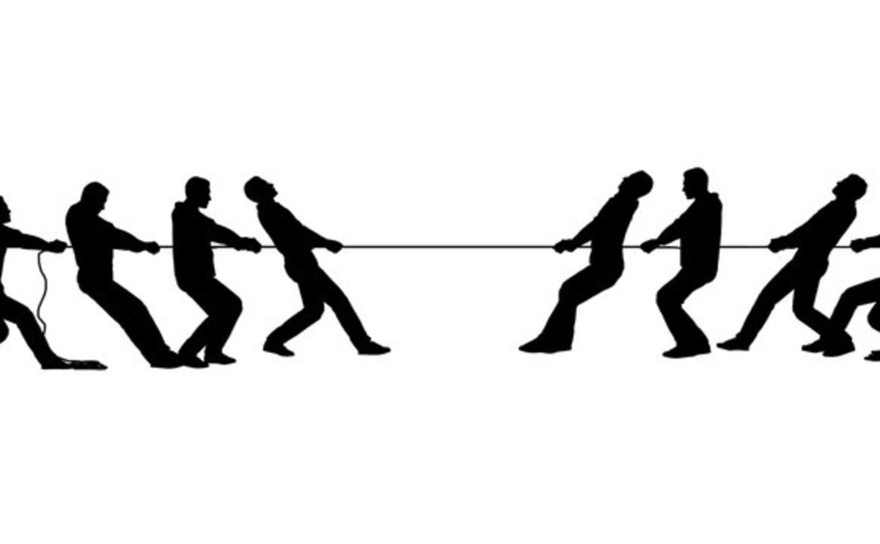
The Real

Slide 4
Conflict and Control
A conflict is said to exist when we see people trying to achieve two or more incompatible goals at once.
From a control theory perspective, a conflict exists when two or more control systems act to get the same (or a very similar) variable into two different states.
Conflict is INHERENTLY A CONTROL PHENOMENON because the basic mechanism of conflict is DISTURBANCE RESISTANCE.

Slide 5
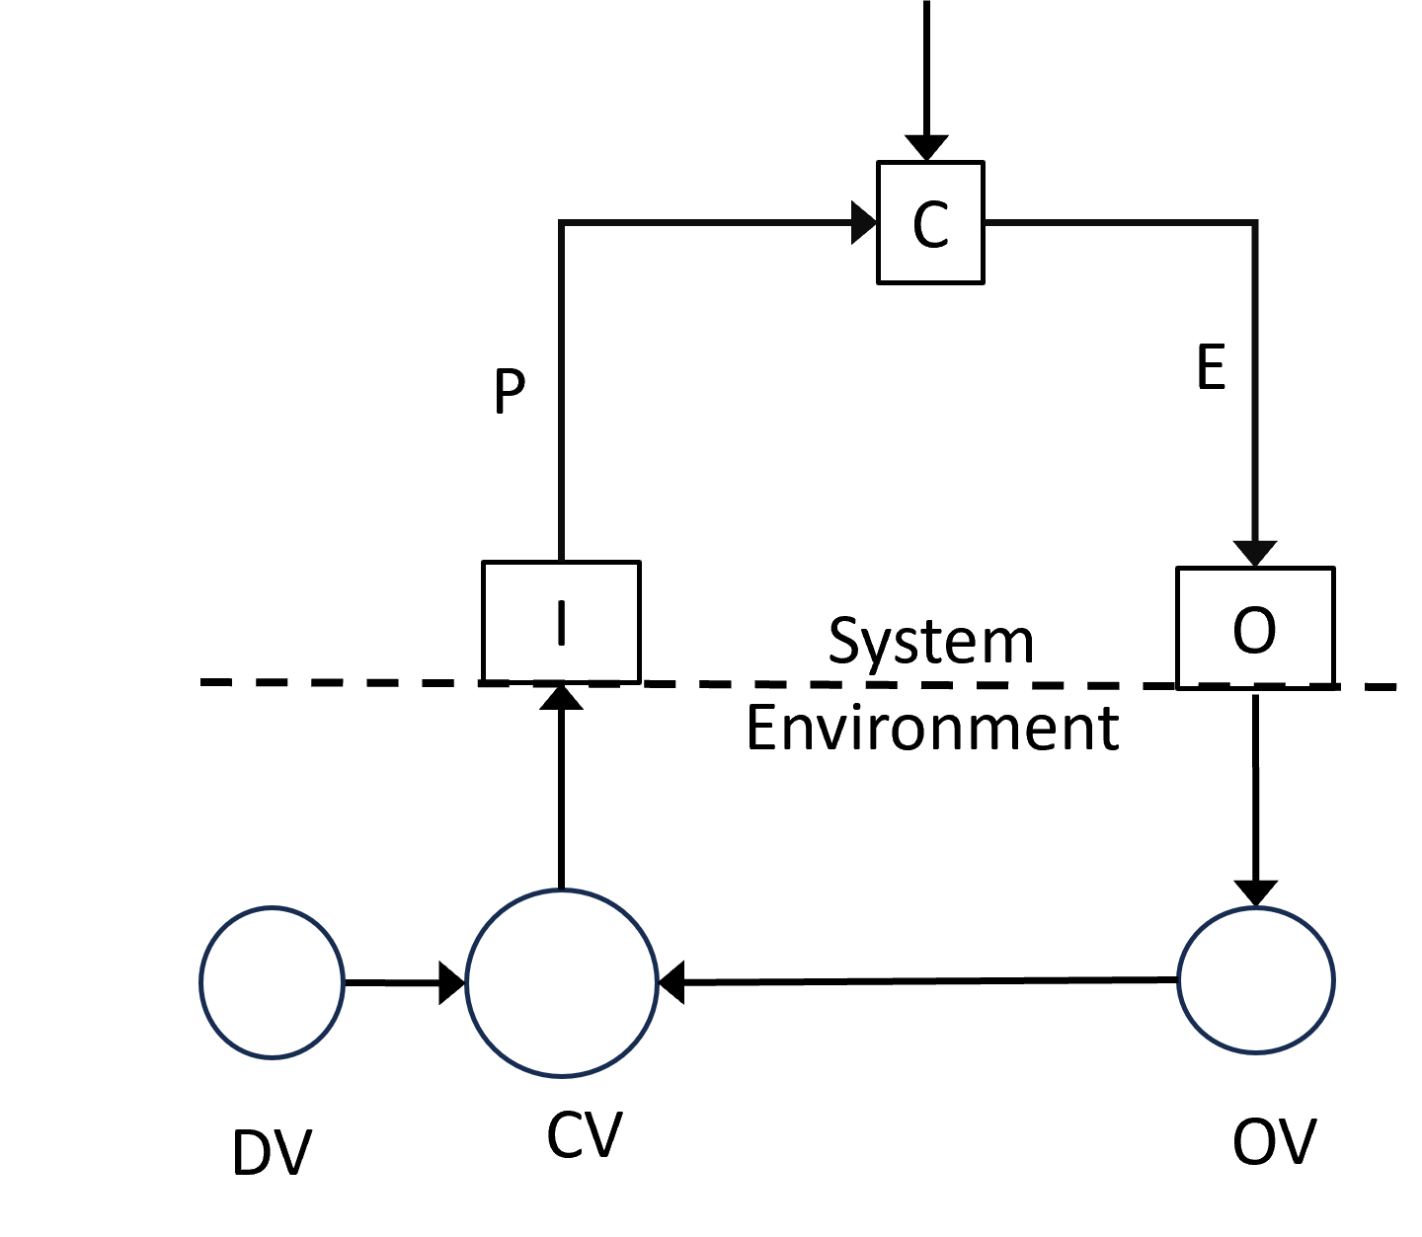
Disturbance Resistance and Control
Control involves maintaining variables in fixed or variable reference states PROTECTED FROM DISTURBANCES (DV).
The variables so maintained are called CONTROLLED VARIABLES (CV).
Disturbances are variations in the environment that affect controlled variables.
A control system AUTOMATICALLY acts, by varying its output (OV) to protect the controlled variable from disturbance, keeping it matching the system’s reference (R).
R

Slide 6
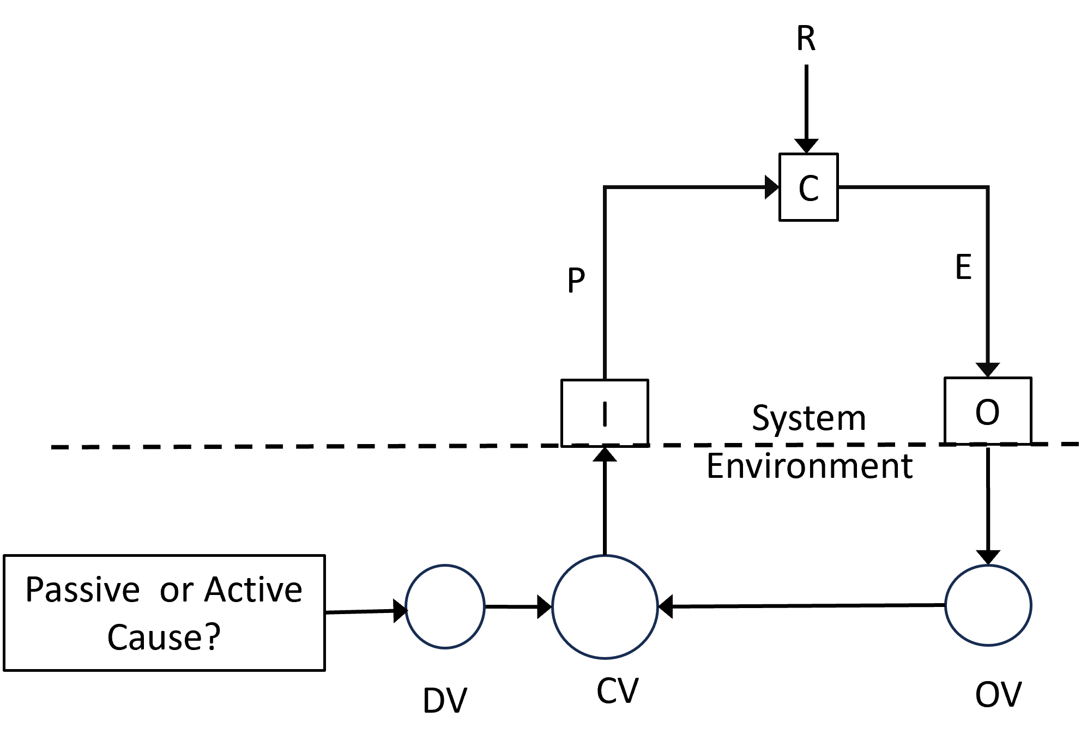
Just Two Kinds of Disturbance in the World
PASSIVE Disturbance
Produced by PHYSICAL (non-purposeful) processes in the environment.
Example: The wind making it difficult to close the door to the storm cellar (see Wizard of Oz, Tornado scene)
ACTIVE Disturbance
Produced by CONTROL (purposeful) processes in a control system.
Example: Another person on the other side of the door trying to open it while you try to keep it closed it (see almost any Horror movie.)

Slide 7
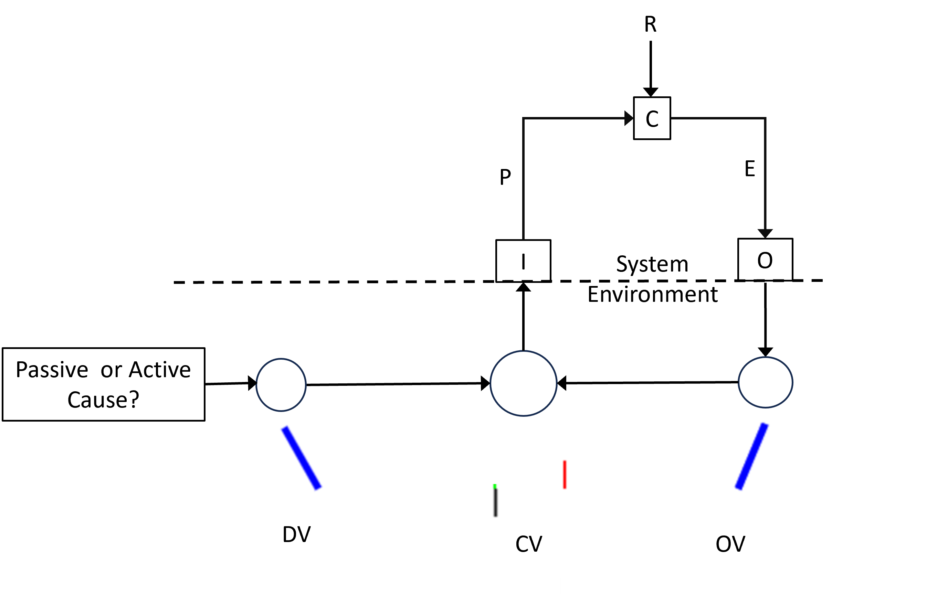
Comparing Resistance to Passive versus Active Disturbance
I’ve developed a simple tracking task to demonstrate the difference in the behavior of a control system resisting a passively versus an actively caused disturbance.

Slide 8
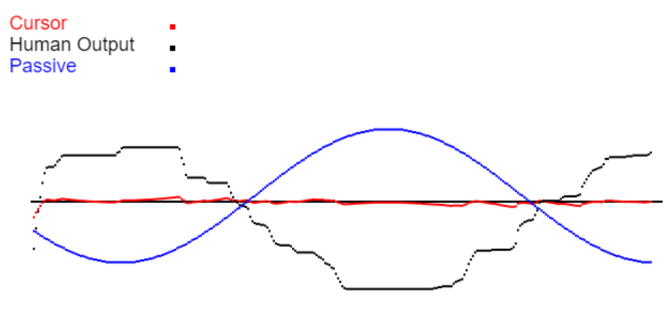
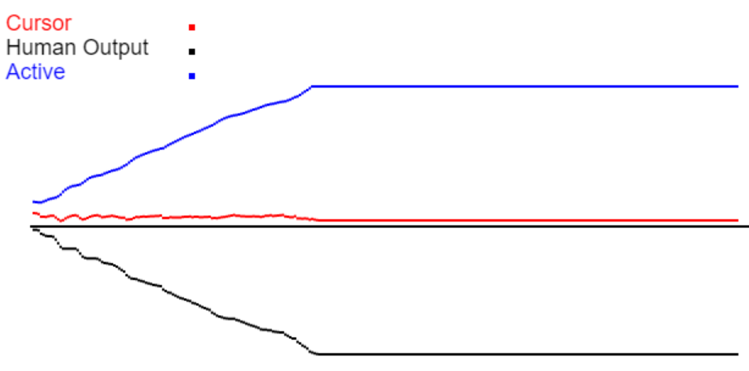
Disturbance Resistance As the Cause of Control and Conflict
In the world of PASSIVE DISTURBANCES – the INANIMATE WORLD – disturbance resistance leads to a DECREASE in the effect of that disturbance on the controlled variable.
The result is CONTROL
In the world of ACTIVE DISTURBANCES – the ANIMATE WORLD – disturbance resistance leads to an INCREASE in the effect of that disturbance on the controlled variable.
The result is CONFLICT.

Slide 9
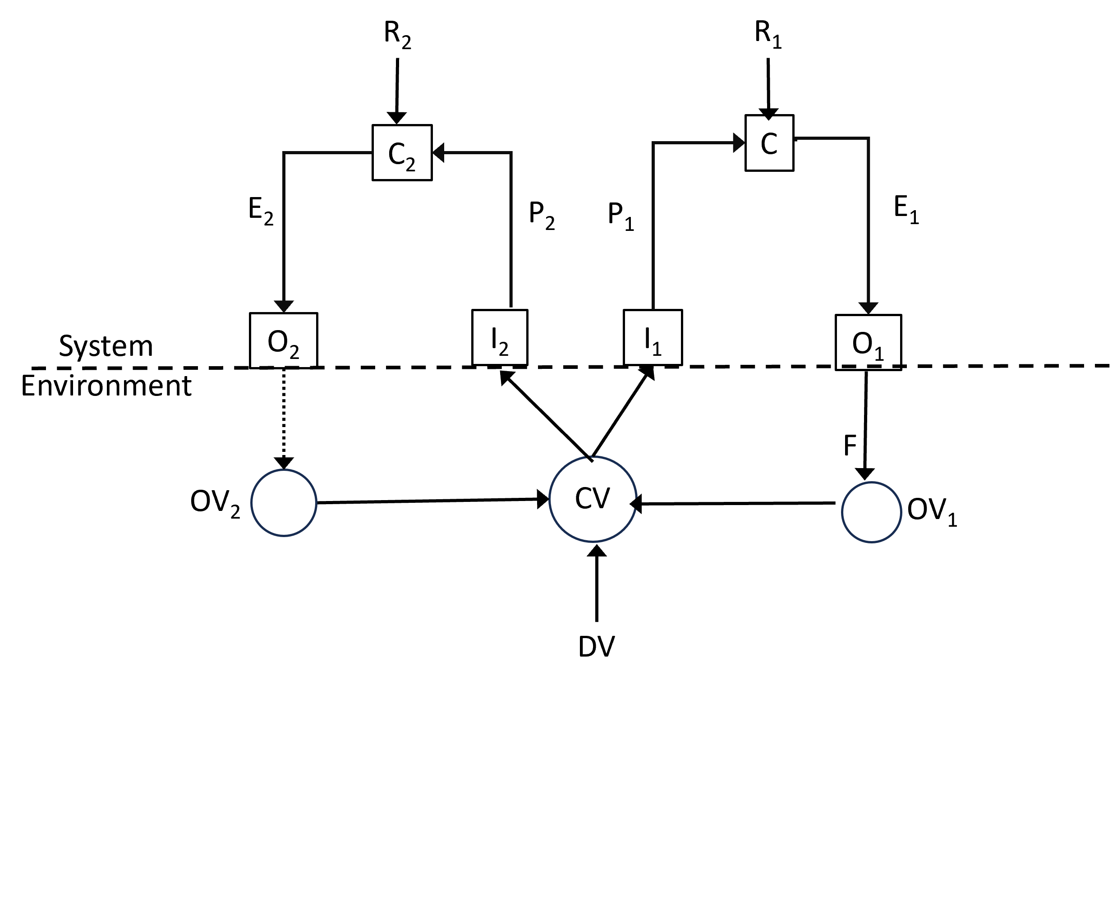
The Basic Control Model of Conflict
Diagram can represent intrapersonal or interpersonal conflict.
It can also represent all the well-known types of conflict:
Approach-Approach (R₁ = T₁ , R₂ = T₂ )
Approach-Avoidance (R₁ = T₁ , R₂ = -T₁ )
Avoidance –Avoidance (R₁ = -T₁ , R₂ = -T₂)
Such conflicts occur within a hierarchy of control systems.
These conflicts are ultimately a result of INCONSISTENT REFERENCE specifications set by HIGHER LEVEL CONTROL SYSTEMS for the SAME CV

Slide 10
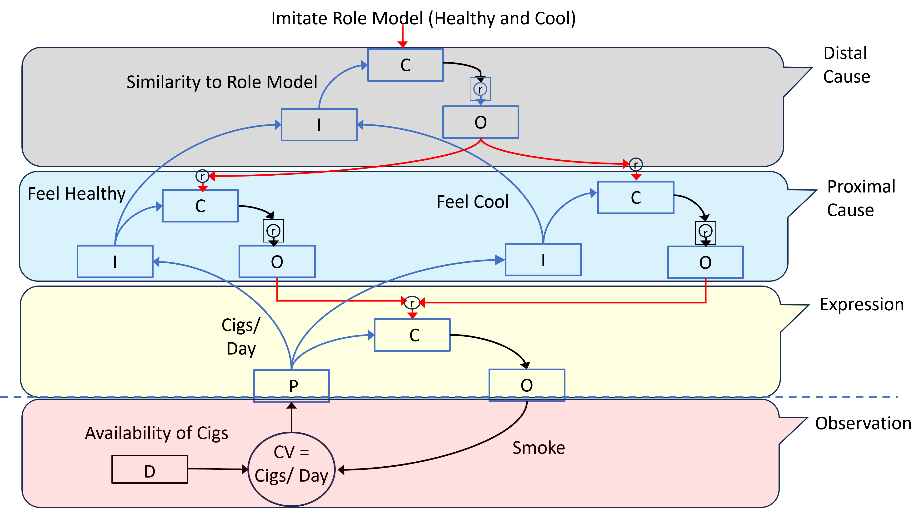
Conflict in a Hierarchy
A 3-level hierarchical control system model of a conflict involving smoking.
Includes description of possible perceptual variables controlled at each level of the hierarchy.
+
+
-
-
+

Slide 11
An Illusion of Control
When control systems are in conflict, they can give the ILLUSION of acting as a single VIRTUAL control system.
This is because:
A variable appears to be kept at a reference level called a VIRTUAL REFERENCE LEVEL (Powers, B:CP, p. 255).
And that variable can appear to be PROTECTED FROM DISTURBANCE (McClelland, 2006).
But virtual control is NOT actual control.
There are LARGE ERROR SIGNALS in the conflicted control systems.
In actual control, error signals are very small.
There is NO ACTUAL DISTURBANCE RESISTANCE.
Due to the existence of a DEAD ZONE around the controlled variable in which there is NO RESISTANCE TO DISTURBANCE (Powers, B:CP, p. 255).

Slide 12
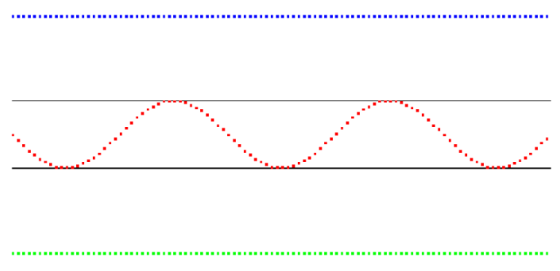
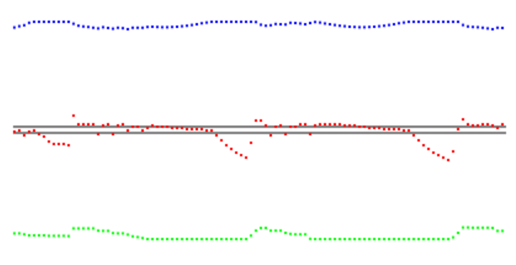
The Dead Zone
R_{T}
R_{U}
R_{T}
The Dead Zone is the REGION BETWEEN THE REFERENCES of the conflicted control systems.
Disturbances that occur WITHIN this zone will NOT be resisted.
R_{U}
Them
Us
Them
Us
O_{T}
O_{T}
I have developed an interactive computer demonstration of the Dead Zone in a conflict.
R_{T}
R_{T}
R_{U}
R_{U}
O_{U}
O_{U}

Slide 13
Possibly Useful Clinical Implication of Dead Zone
Could be used as way to determine the magnitude of a conflict
In terms of the size of the discrepancy between two conflicting references (goals).
Magnitude of conflict measured by observing maximum size of disturbances that are NOT resisted.
This would require having at least a quasi-quantitative notion of the amplitude of disturbances to a “virtually” controlled variable.
For example, what’s the maximum size of a dessert that a person with an eating disorder CANNOT resist.
What’s the maximum size of a drink that a person with a drinking problem CANNOT resist.

Slide 14
The Bad (In my opinion)

Slide 15
Conflict: Control Eliminating Control
Spreadsheet demo of the main consequence of conflict
Which is “to remove parts of the brain’s [control] organizations from action as effectively as if they had been cut out with a knife, yet without getting rid of their undesirable influences on the whole hierarchy.” (Powers, B:CP, p 253-254)

Slide 16
The Good (Maybe?)

Slide 17
What’s So Good About Conflict?
Entertainment
Sports (good games).
Literature (good stories).
Science & Innovation
Scientific debates lead to new hypotheses and, most important, tests of these hypotheses.
Innovation can be accelerated by competition to produce a better product.
Economics
Free and Fair markets (but without monopolies, Linda Kahn, Chain FTC).
Common Theme: All these conflicts are “good” to the extent that they are REGULATED (CONTROLLED).

Slide 18
Conclusion
Conflict (intra or interpersonal) is almost always a bad thing unless it’s done under carefully regulated conditions (as in sports or economies).

